Slide 1
Drillthrough
Drillthrough

Slide 2
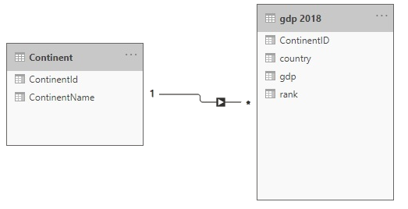
Drill through
Note: This workshop uses the gdp.xlsx file located in the resources\ Drillthrough folder and Filters
Navigate to the location of the gdp.xlsx file and load both tables continent
and GDP 2018 in the query editor.
Check that the relationship between continent and gdp 2018 is well established.

Slide 3
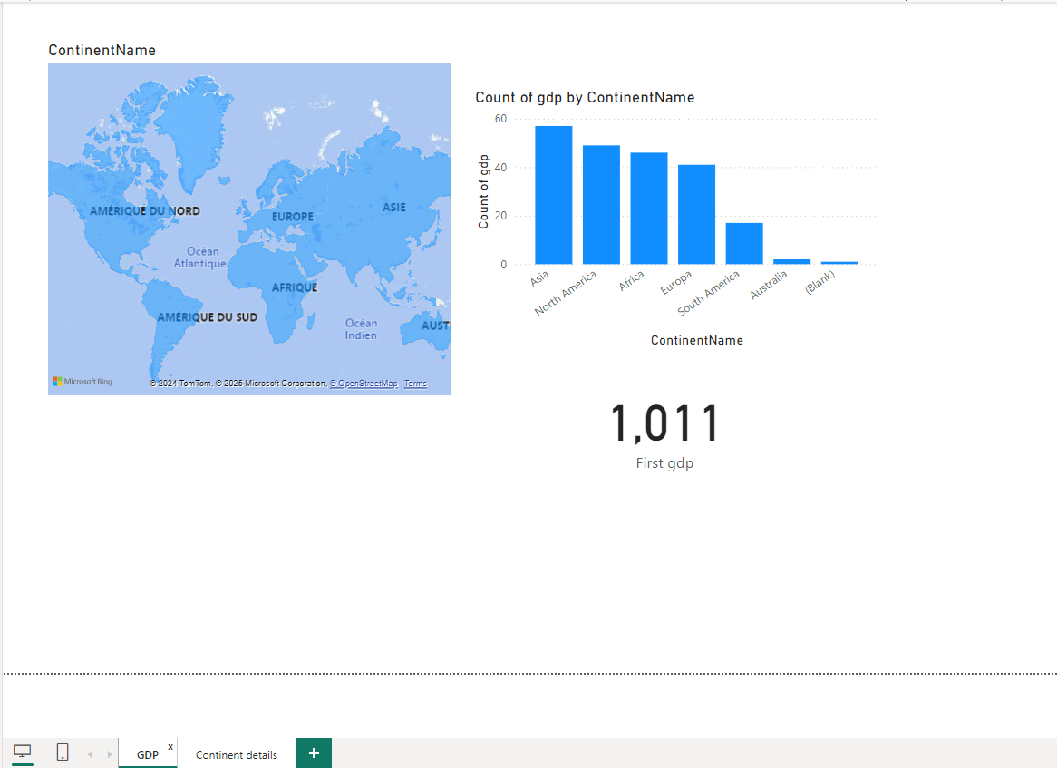
Drill through
Name two pages of the report:
GDP
Continent details

Slide 4
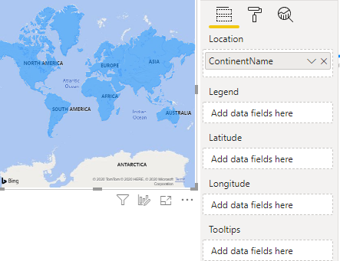
Drill through
Add three visuals on the GDP page :
A geographical map
A histogram
A label visual
ContinentName field to the Location property .

Slide 5
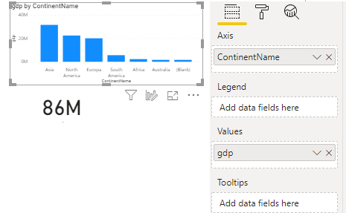
Drill through
Configure the histogram :
Add ContinentName to Axis .
Add gdp to Values .

Slide 6
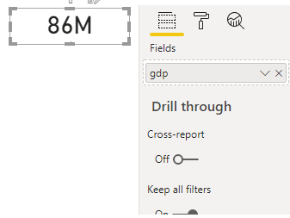
Drill through
gdp field to the Fields property

Slide 7
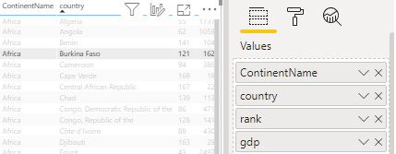
Drill through
Add a table visual on the Details page and add the following fields:
ContinentName
Country
Rank
GDP

Slide 8
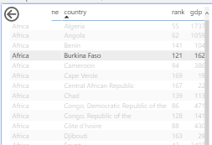
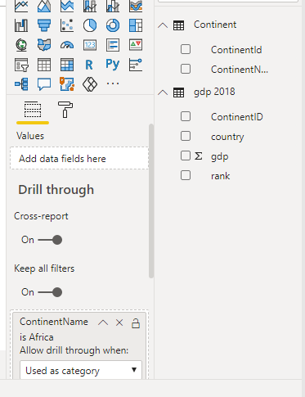
Drill through
Slide ContainsName at the area level Dill through
Details page level

Slide 9
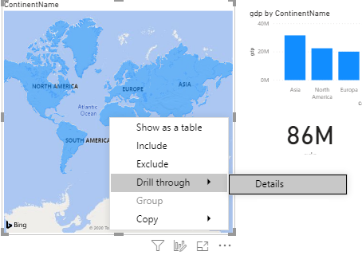
Drill through
Return to the GDP page and right-click on Africa.
Note the presence of the Drillthrough menu

Slide 10
Drill through
Click the Details menu and see what happens.

Slide 11
THANKS
THANKS

